Slide 1
Dengue graphs of 2008 to 2016
By Troy and Intil

Slide 2
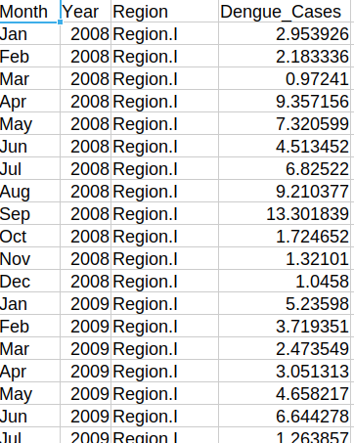
The data
This Dataset contains the recorded number of dengue cases per 100,000 population per region of the Philippines from 2008 to 2016. We used python with matplotlib and pandas module to read, clean, and visualize our Dataset.

Slide 3
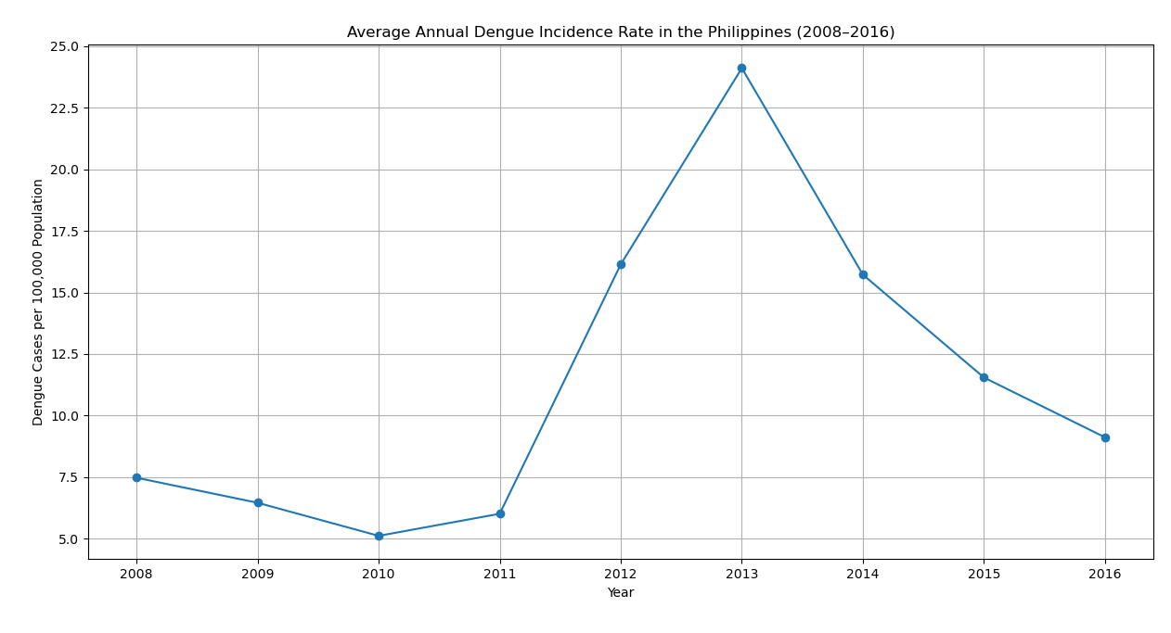
Line Graph.
This shows the average annual dengue incidence rate per 100,000 population across all Philippine regions from 2008 to 2016. The trend reflects changes in dengue intensity over time, independent of regional population size.

Slide 4
Line Graph.

Slide 5
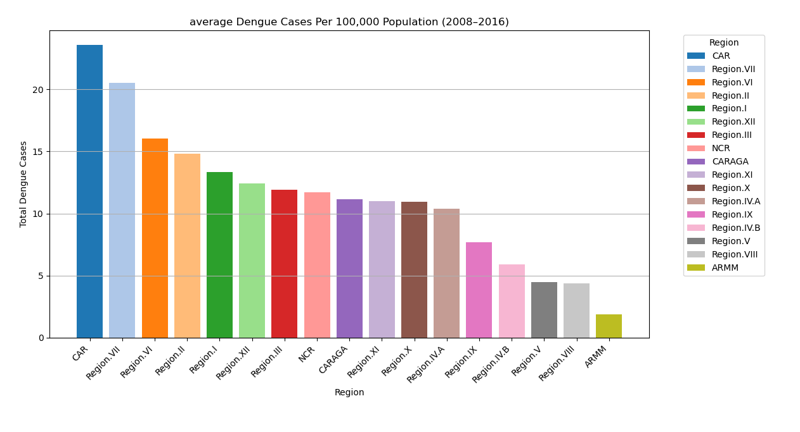
Per region bar Graph.
This shows the cumulative dengue incidence rate per 100,000 population for each Philippine region from 2008 to 2016. Higher values indicate regions that consistently experienced higher dengue incidence relative to their population size.

Slide 6
Per region bar Graph.

Slide 7
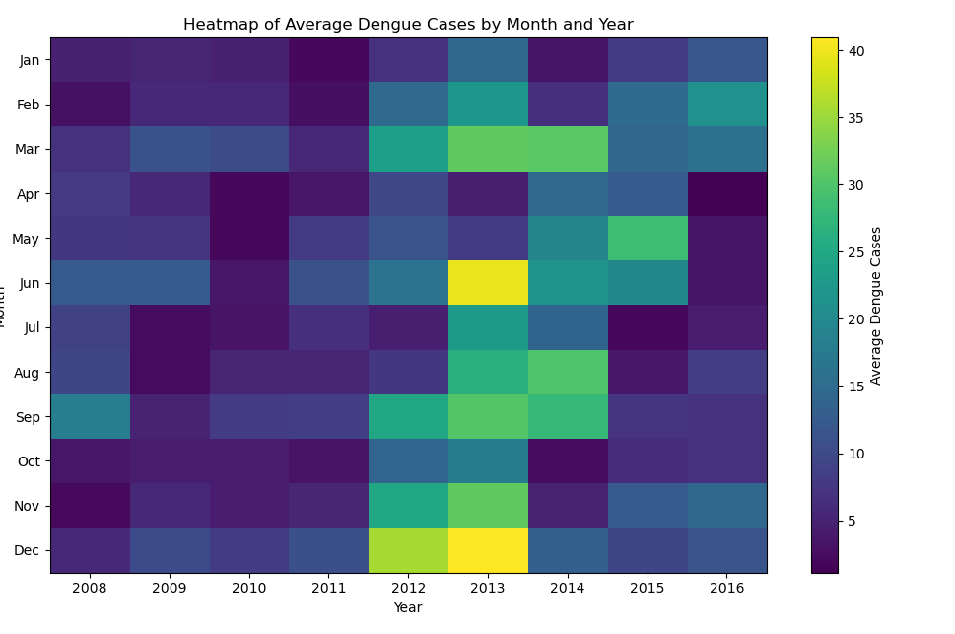
Heatmap
This heatmap shows the average number of dengue cases by month and year. Each cell represents how severe dengue cases were for a specific month in a specific year.

Slide 8
Heatmap

Slide 9
Why Line Graph?
Show changes over time
Clearly display year-to-year trends in dengue incidence
Make it easy to identify peaks, declines, and long-term patterns
Supports comparison across years without visual clutter

Slide 10
Why Bar Graph?
Compare regions
Bar graphs allow direct comparison between categories
Effectively highlight regional differences in dengue burden
Summarizing data as averages reduces noise from monthly fluctuations
Easy to interpret for both technical and non-technical audiences

Slide 11
Why Heatmap?
It handles Two Variables of Time simultaneously
. Spotting "Seasonal Drift"
Identifying "hot spots" & seasons.

Slide 12
Why not other Charts?
Pie Charts are not good good because there are too many years and many regions.
A standard scatter plot usually compares two continuous variables (like height vs. Weight, X axis and Y axis).
Radar charts become unreadable "spaghetti" once you add more than 3 or 4 variables

Slide 13

Goodbyezzzzz
Source Codes for learning opps:
  https://github.com/AlieeLinux/Visualization-Course-IDK

